Slide 1

Applied Time Series project
Microsoft Stock predictions

Slide 2
Scope of this project
In this presentation, we will embark on an analytical journey through the realm of financial time series, focusing on the illustrious case of Microsoft Corporation (MSFT). Our primary objective is to harness the power of time series analysis to predict MSFT's stock price, a goal rooted in both its academic intrigue and practical significance in the financial world.
The ability to predict stock prices holds immense value, offering insights into potential future market movements and guiding investment strategies. It encapsulates a blend of quantitative analysis, data science, and financial theory, aimed at deciphering the patterns and signals embedded within historical stock prices. Our exploration into MSFT's stock price prediction is not just an academic exercise but a step towards understanding the dynamics of financial markets and enhancing decision-making processes.

Slide 3
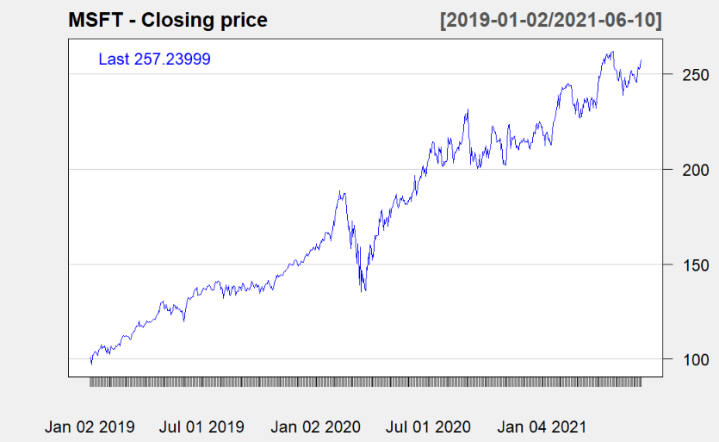
Time series plot of our data
Overall Trend: The plot reveals a clear upward trend, indicating that MSFT's market value has generally been increasing over this 2.5-year period. This could suggest strong company performance and investor confidence.
Volatility and Market Events: While the trend is upward, there are noticeable fluctuations that could correspond to market events, quarterly earnings reports, or broader economic changes. For instance, any sharp declines could potentially coincide with market-wide sell-offs or poor earnings results, whereas sharp increases might be related to positive news or financial reports.
Market Dynamics: Discuss the significant rise in stock price, particularly from mid-2019 to early 2020, and a more variable pattern thereafter. This could be further analyzed in the context of the company's operational achievements or external factors.

Slide 4
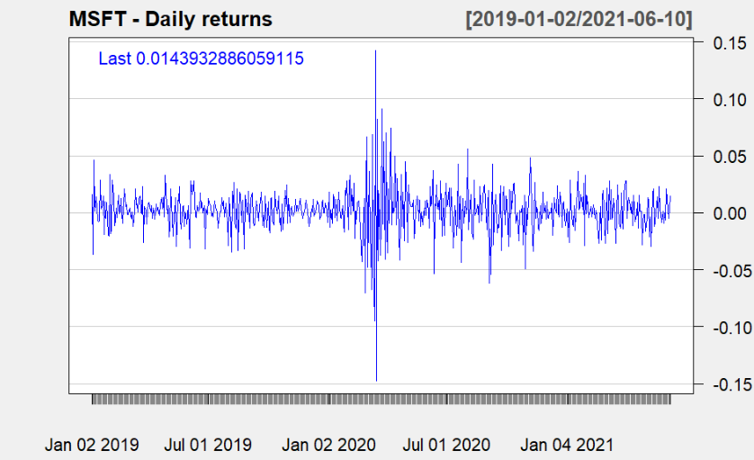
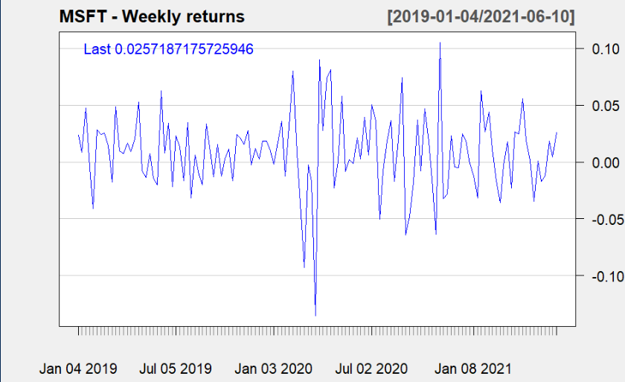
Daily returns
Weekly
returns

Slide 5
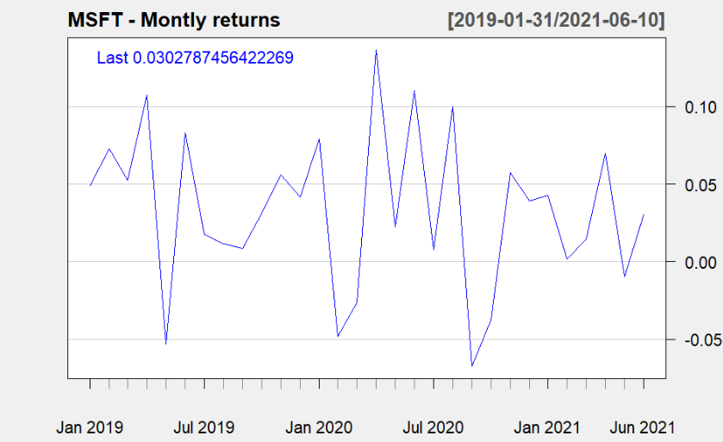
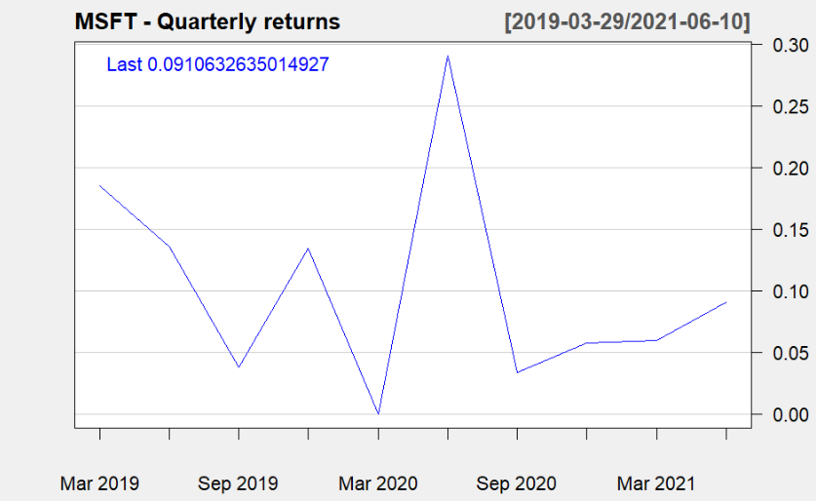
Daily returns
Monthly returns
quarterly
returns

Slide 6
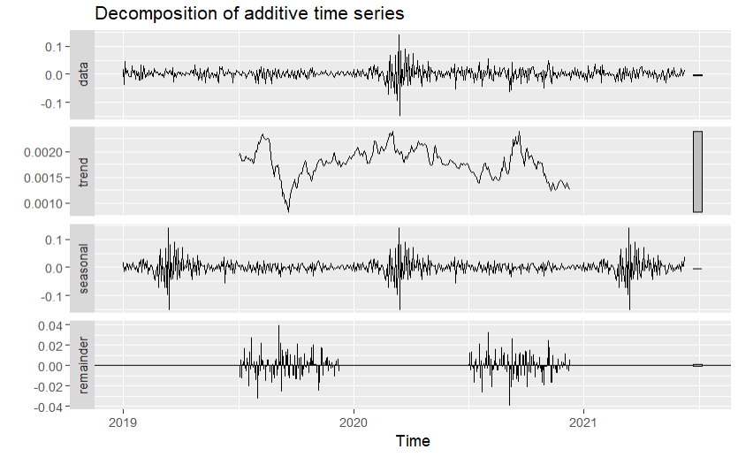
Decomposition
The original data is relatively stable over time, without clear trends or seasonality.
The trend component varies slightly but generally remains close to a constant mean, indicating little long-term trend in the data.
The seasonal plot does not display a consistent pattern, suggesting seasonality is not a significant factor in this series.
The remainder (residuals) component exhibits random fluctuations, which is characteristic of a white noise process.

Slide 7
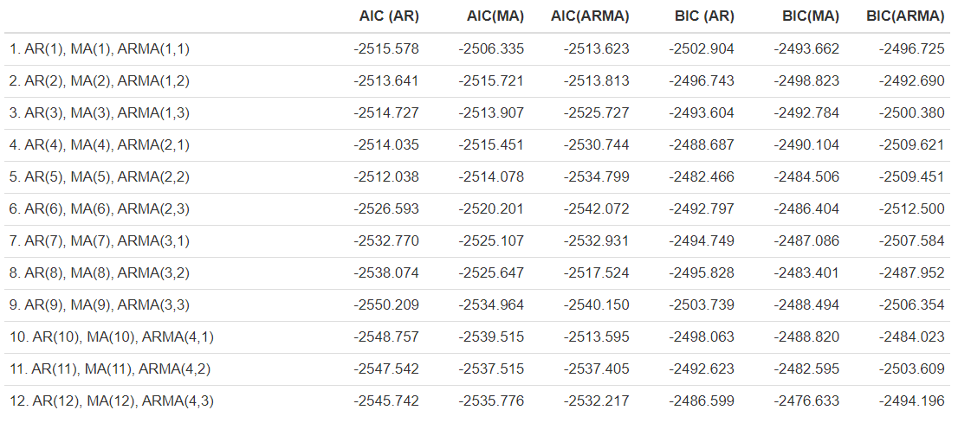
Model comparison
Models Compared: It compares 12 different models, each with increasing order of AR and MA components. For example, AR(1), MA(1) for the first model, up to AR(12), MA(12) for the twelfth model.
Criteria for Model Selection: AIC and BIC are both used to assess the quality of each model. Generally, lower values are better, indicating a more suitable model for the data.
Optimal Model: Without the specific values being legible, one would typically look for the model(s) with the lowest AIC and BIC values to identify the best-fitting model.
Best Model Indicator: The table is likely sorted by increasing complexity of the models. The goal is to find a model with the lowest AIC and BIC, suggesting an optimal balance between model fit and complexity.

Slide 8
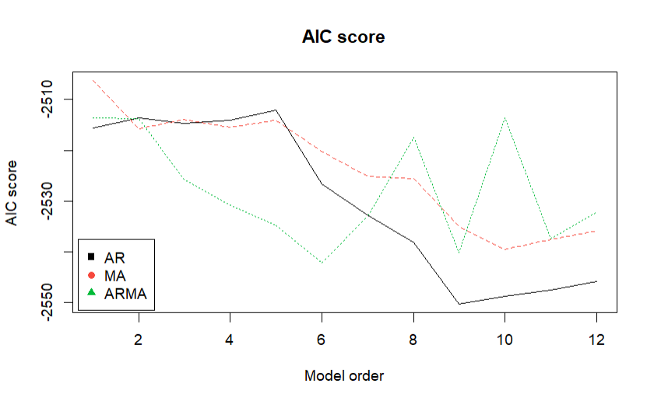
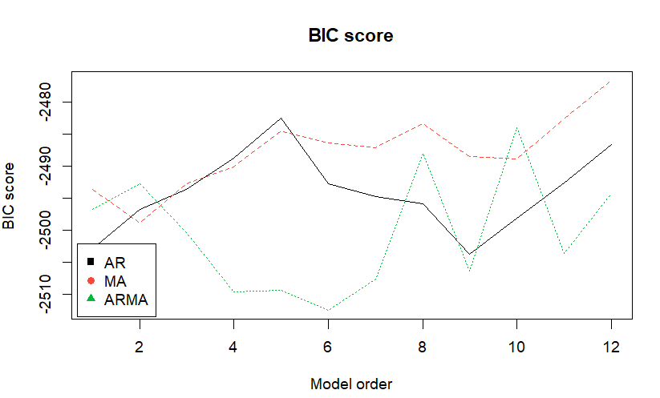
Daily returns
AIC score graph
Bic score graph

Slide 9
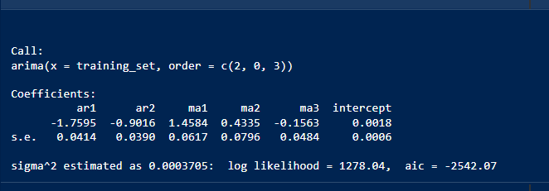
ARMA (2,0,3) model
This output is the results from an ARIMA(2,0,3) model.
The estimated coefficients for the AR terms are -1.7595 and -0.9016, and for the MA terms, they are 1.4584, 0.4335, and -0.1563, with a small positive intercept of 0.0018.
The standard errors are relatively small, suggesting the coefficients are estimated with precision.
The variance of the model's residuals (sigma^2) is very low at 0.0003705, indicating a good fit, and the log-likelihood and AIC values suggest the model is a strong candidate for capturing the patterns in the data.

Slide 10
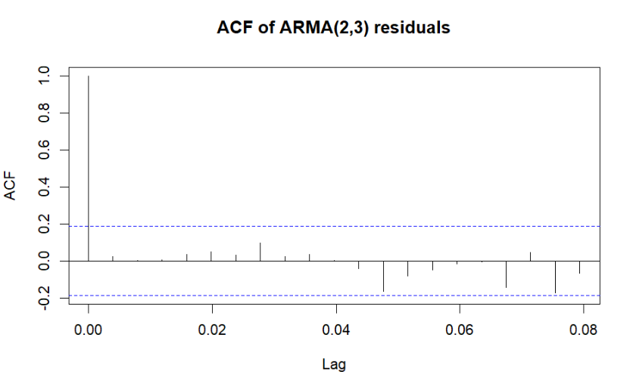
ACF of residuals of final model
The ACF plot of ARMA(2,3) residuals indicates that there is no significant autocorrelation present in the residuals, suggesting that the ARMA(2,3) model captures the time series data well.

Slide 11

Model msfe comparison
This table displays the Mean Squared Forecast Error (MSFE) for four different models: ARMA(2,3), ARMA(2,2), ARMA(2,1), and AR(8). The ARMA(2,2) model has the lowest MSFE (0.0002334), suggesting it provides the most accurate forecasts among the ones listed, followed closely by ARMA(2,3) and ARMA(2,1). The AR(8) model has the highest forecast error, making it the least accurate in this comparison.

Slide 12
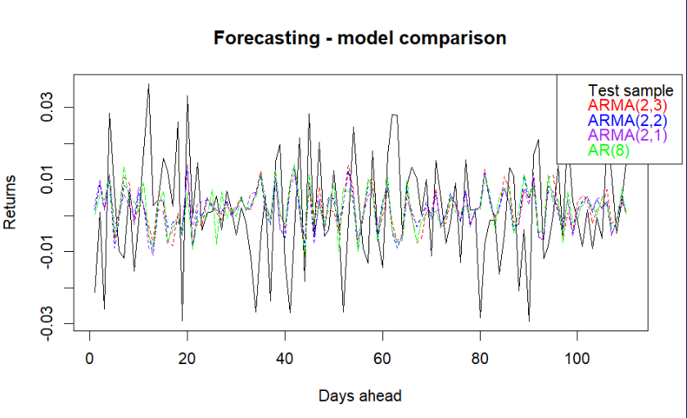
Forecast comparison
This plot compares the forecasted returns of different models over 100 days. The ARMA(2,3), ARMA(2,2), ARMA(2,1), and AR(8) models are plotted against the actual test sample returns. All models seem to follow the test sample's volatility to a degree, but none captures all the movements perfectly, which is common in financial time series forecasting due to market inefficiency and noise.

Slide 13
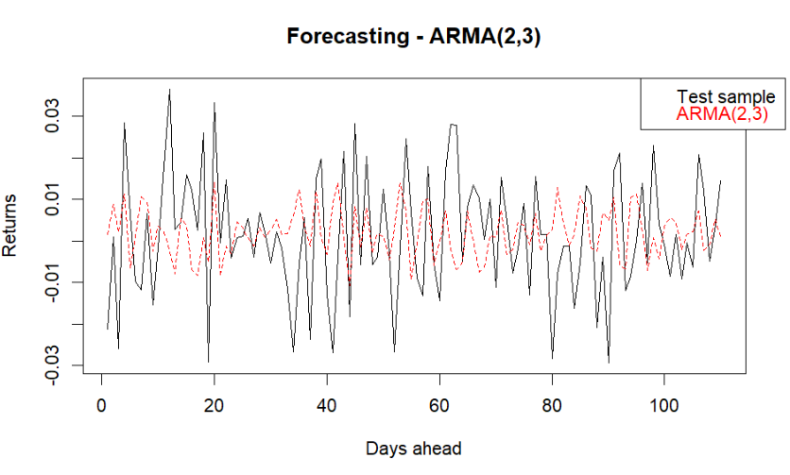
forecasts
The plot presents a forecasting model using an ARMA(2,3) approach, where the solid black line represents actual returns over a period, and the dotted red line shows the forecasted returns based on the model. The graph illustrates the model's performance over approximately 100 days, demonstrating its ability to capture the general pattern of the returns, albeit with some deviation from the actual values, indicating the potential predictive power as well as limitations of the ARMA(2,3) model in this context.

